Slide 1


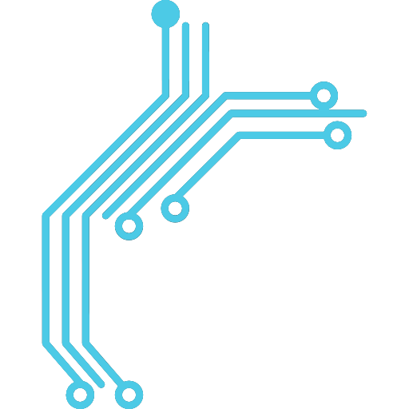

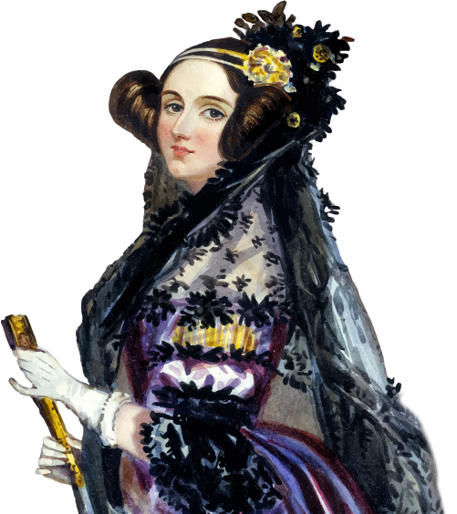
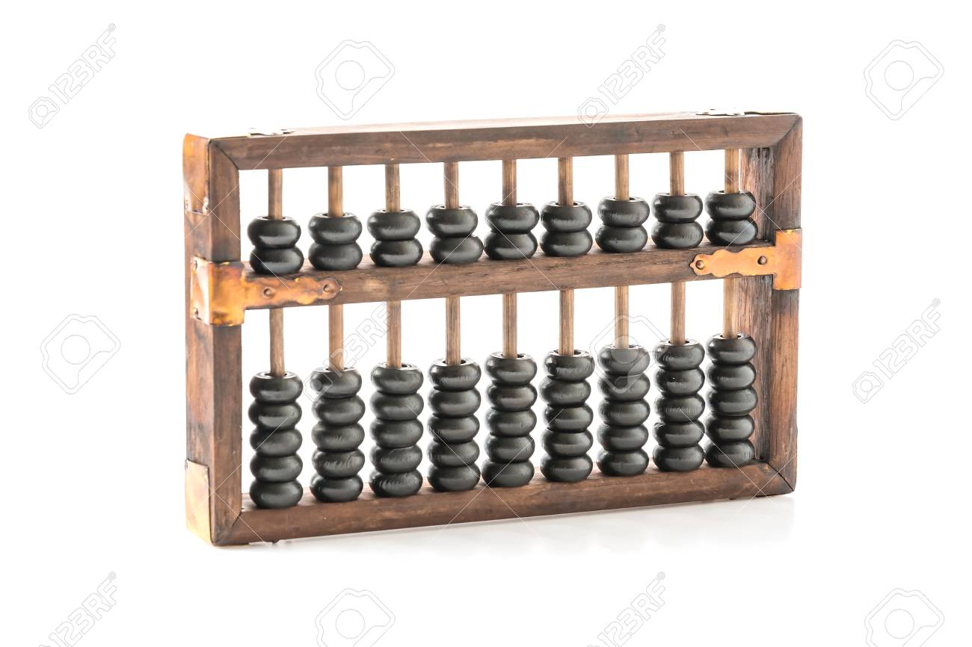
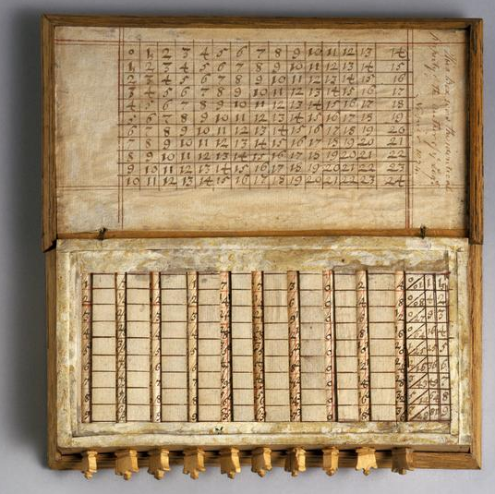
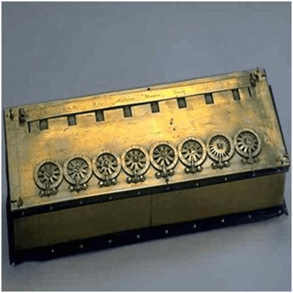
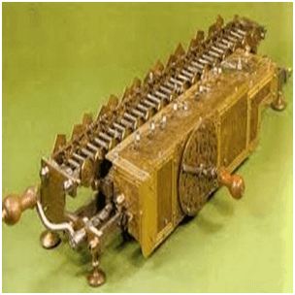
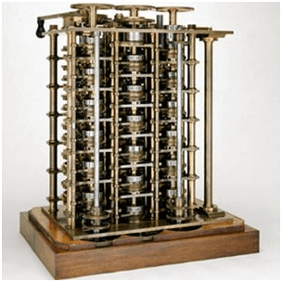
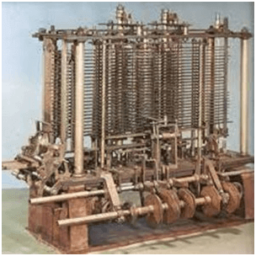
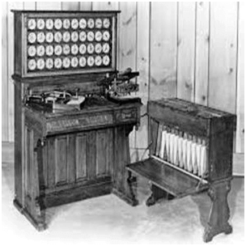
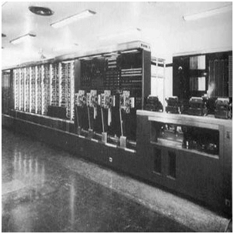


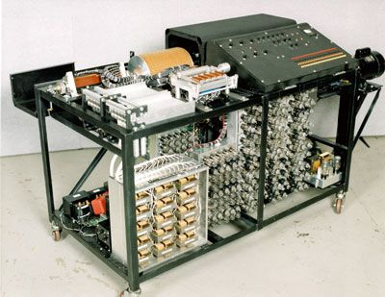
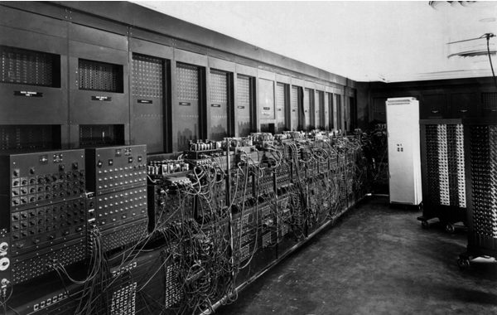
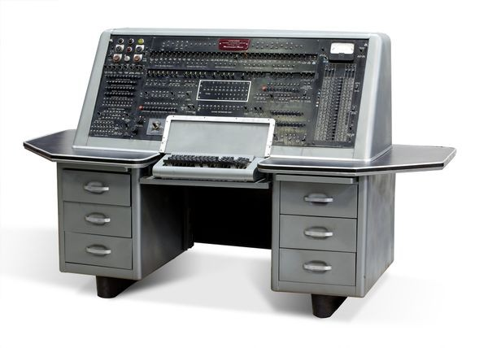
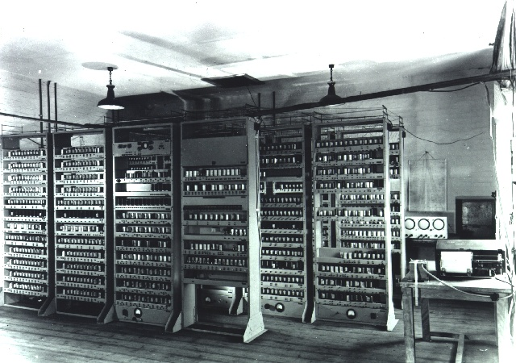
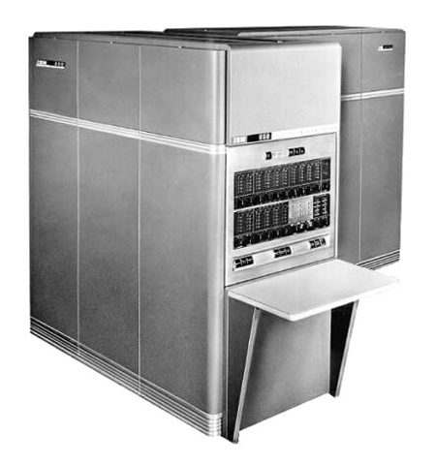
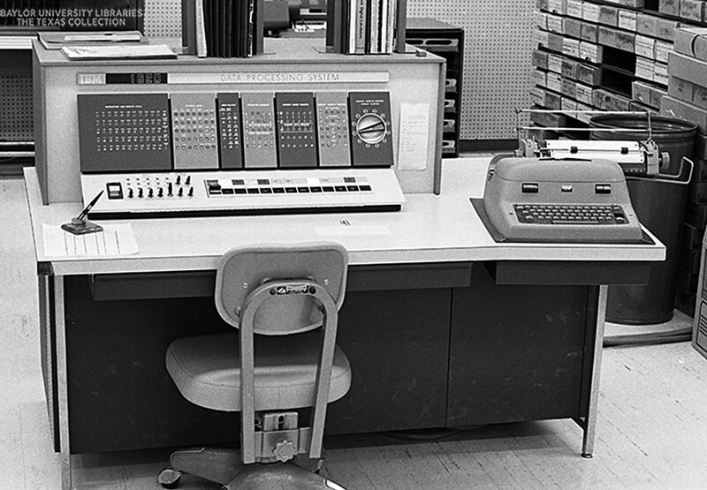
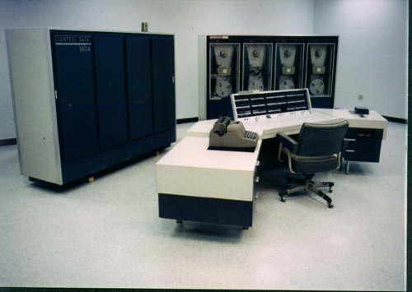
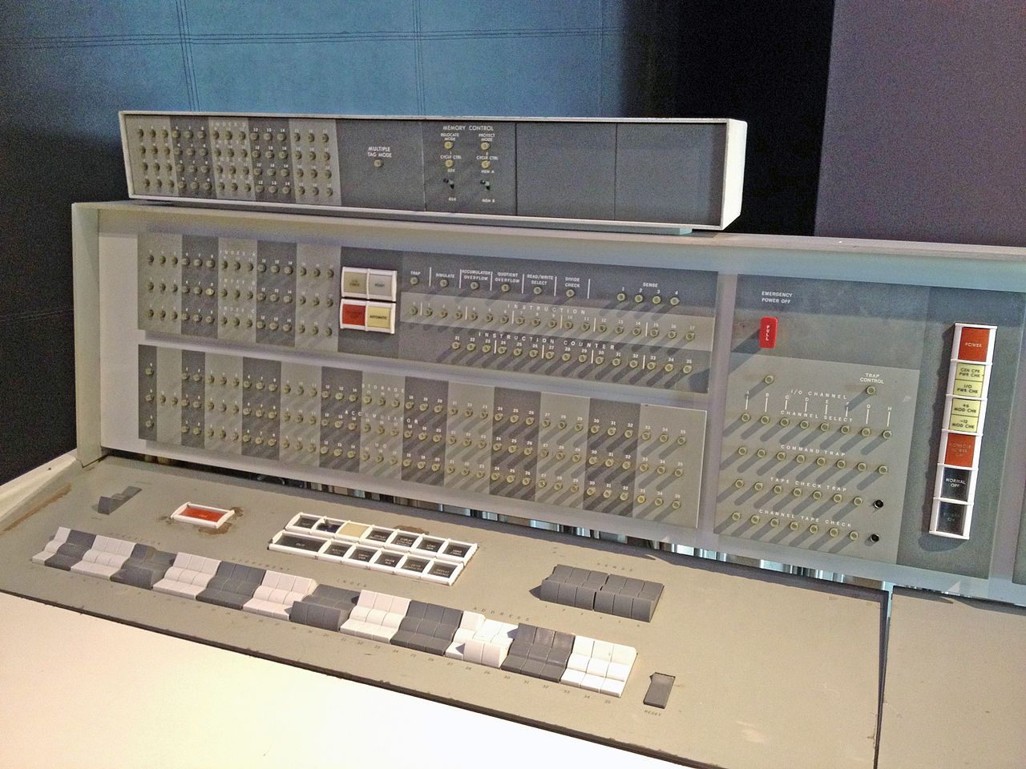
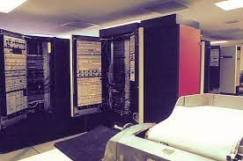
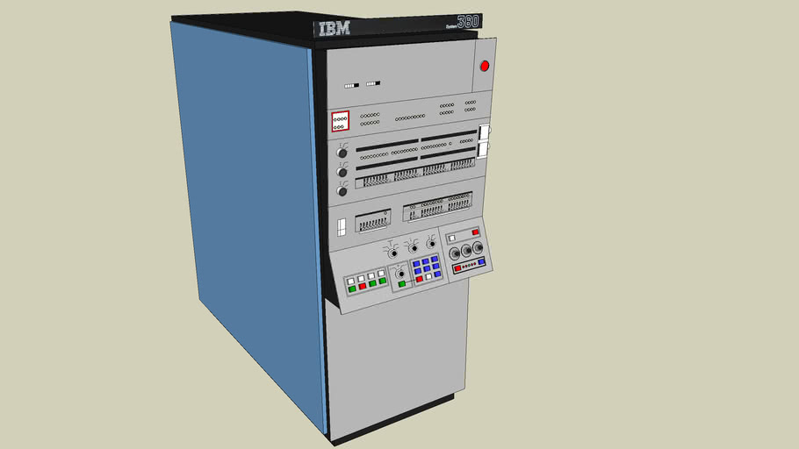
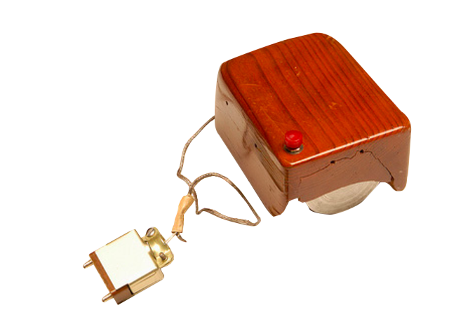
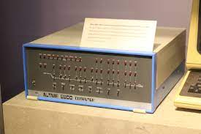
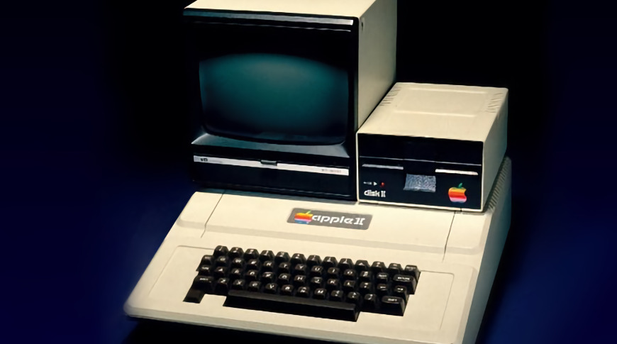
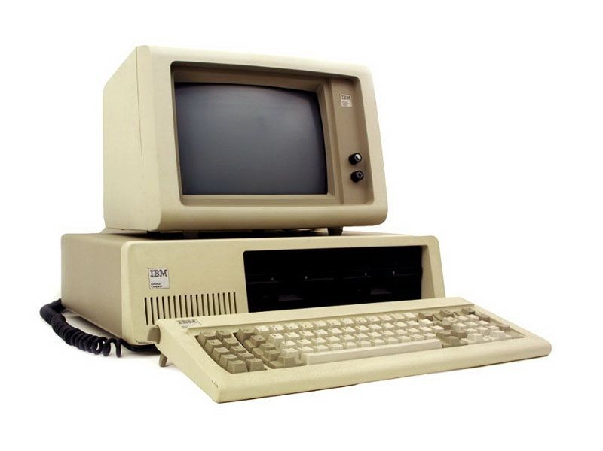
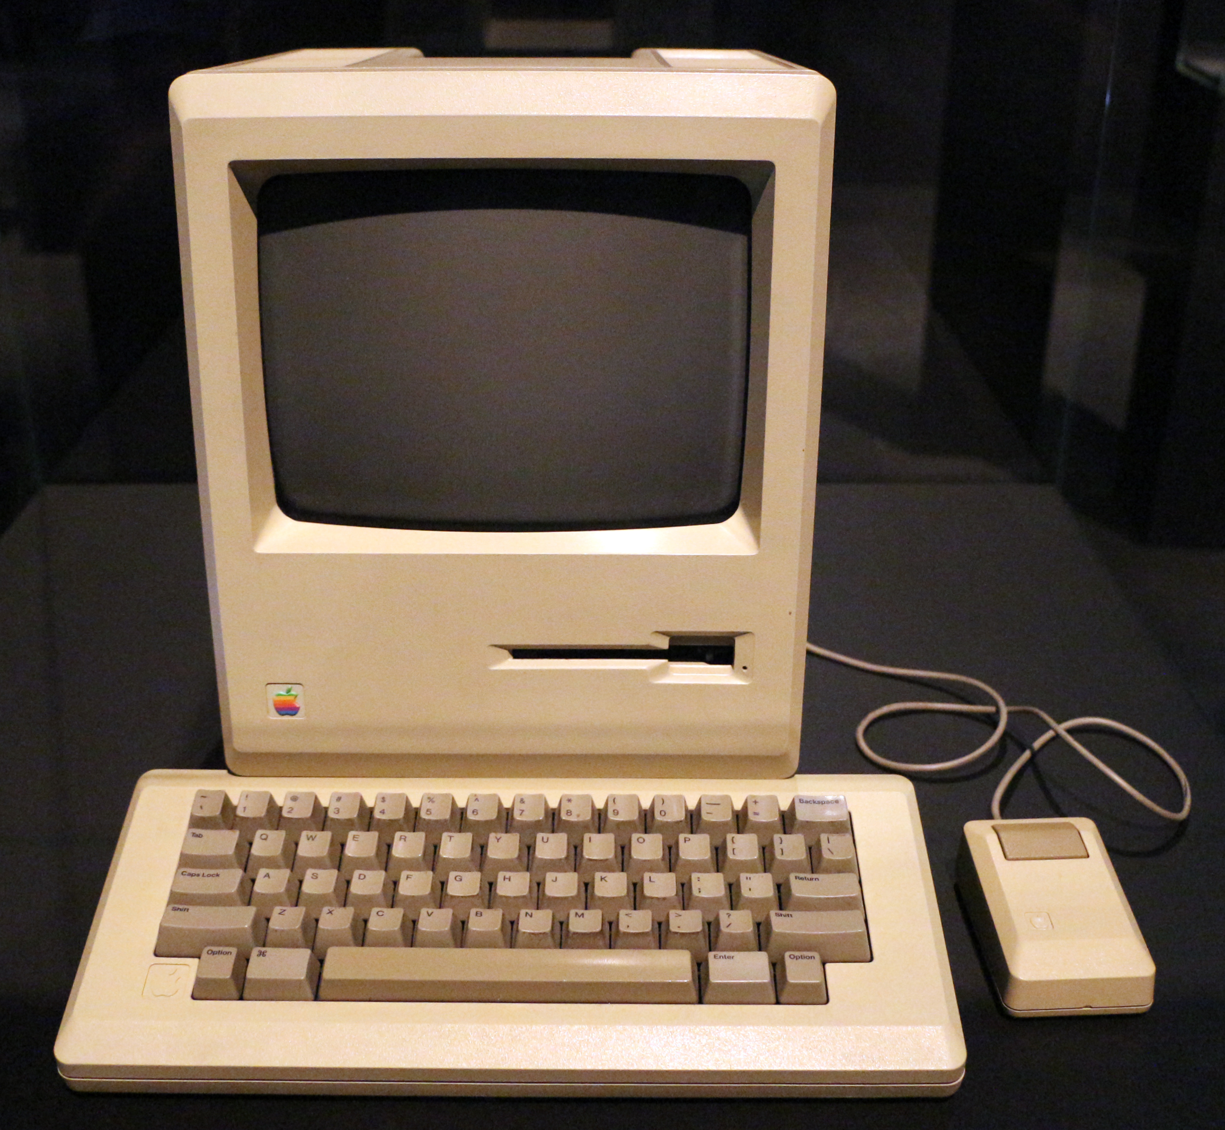
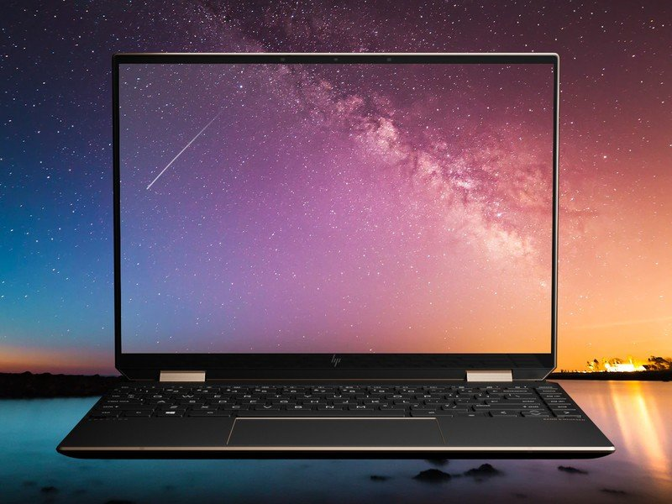
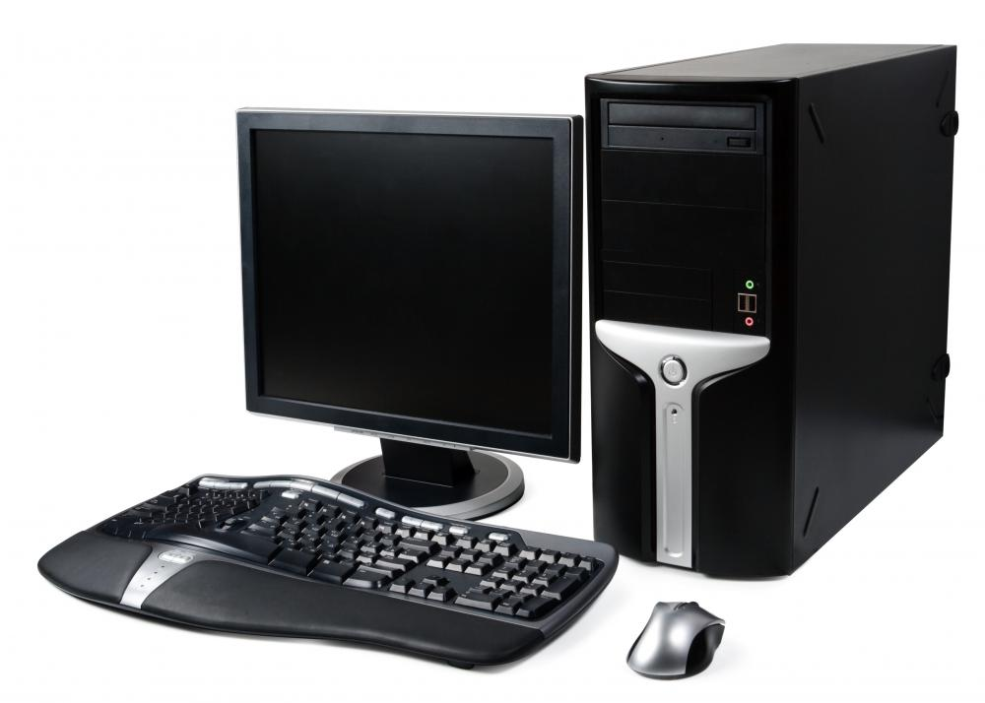
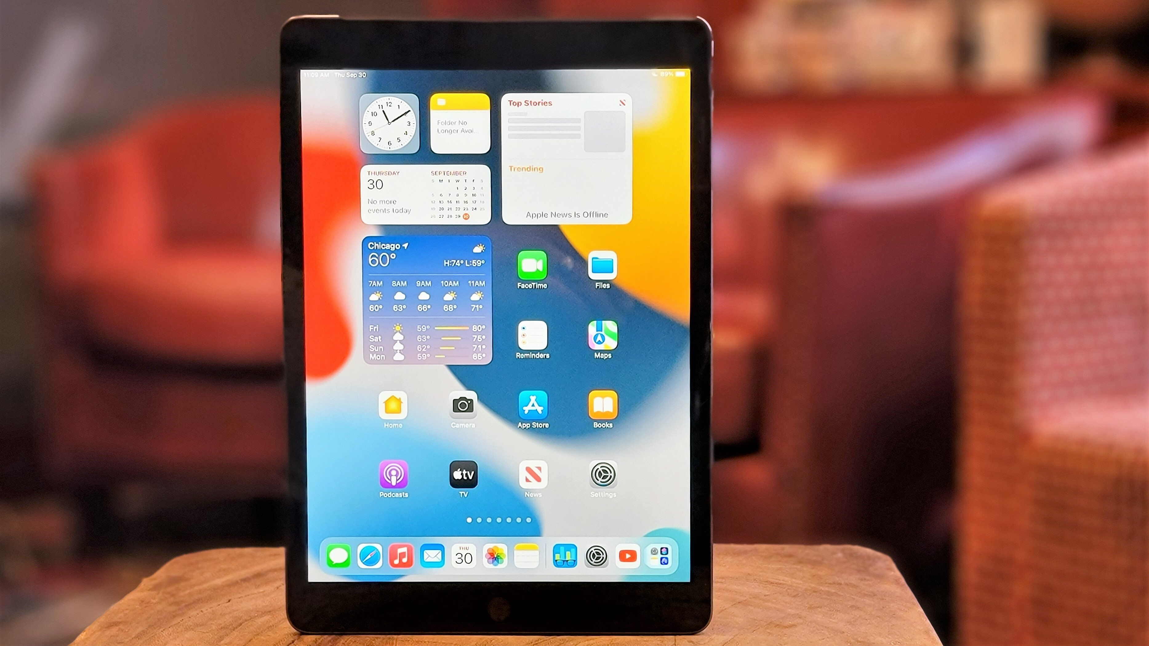
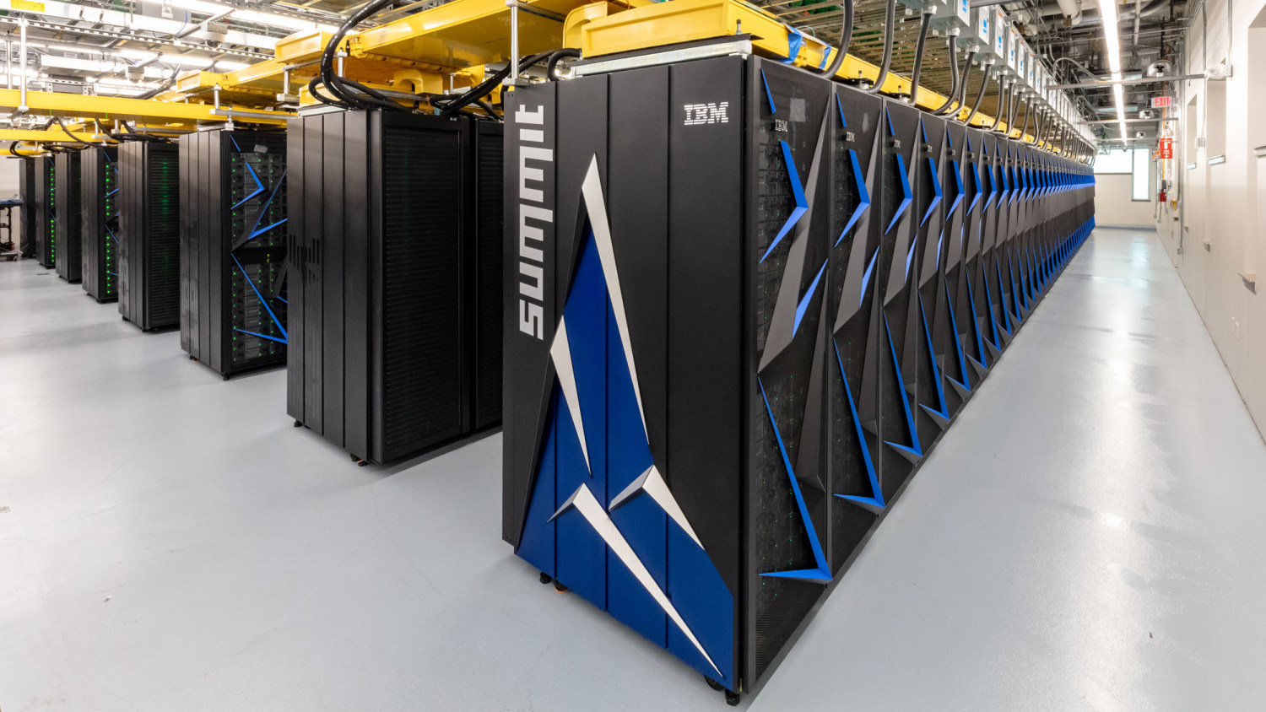

A BRIEF
HISTORY OF
COMPUTER
EARLY COMPUTER
COMPUTER PROGRAMMER
THE FIRST
IS A WOMAN
Abacus
Her name is Ada Lovelace, & she lived in England, where she worked as a
mathematician & writer. She is
famous for working on the
“Analytical Engine.”
It is believe to be the first computer.
It is a wooden rack with beads mounted
on them. The beads is moved to perform
arithmetic calculations.
Napier’s Bone
1200 C.E.
Pascaline
The first machine to use a decimal point.
A manually-operated calculating device
that can multiply & divide. It is invented
by John Napier.
It is the first mechanical & automatic
calculator. A wooden box with a series of
gears & wheels that can perform addition &
subtraction. It is invented by Blaise Pascal
1550-1617
1642-1644
Leibnitz Wheel
Difference Engine
An improved version of Pascaline
developed by Gottfried Leibnitz. It is made
with fluted drums instead of gears. It can
perform all four arithmetic operations.
It is a mechanical computer that could
perform simple calculations. It is steam
driven machine designed to solve table of
numbers like logarithm table.
1673
1820
Analytical Engine
Tabulating Machine
It is a mechanical computer that uses
punch-cards as input. It is capable of solving
any mathematical problem & storing
information as a permanent memory.
A mechanical tabulator that could
tabulate statistics & record or sort data
or information based on punch-cards.
It is invented by Herman Hollerith
1830
1890
Mark I
The first counting device uses sticks, stones & bones as counting tools. As human mind & technology improved with time more computing devices were developed to ease computing.
It is the first programmable digital
computer. It could perform calculations
involving large numbers. Developed by
Howard Aiken with IBM & Harvard.
FIRST GENERATION
1550-1617
The first
electronic computer
ENIAC weighed more than
27 tons & took up 1800
square feet.
ABC
ENIAC
Stands for Atanasoff-Berry Computer. It is
the first electronic digital computing device.
It is invented by Prof. John Atanasoff &
Clifford Berry at Iowa State University.
Stands for Electronic Numerical
Integrator & Computer. It is the first
electronic-general purpose computer. It is
invented by John Prester & John Mauchly.
1939-1942
1946
UNIVAC 1
EDVAC
Stands for UNIVersal Automatic Computer
1. It is the first commercial computer. It is
also invented by John Prester & John
Mauchly.
Stands for Electronic Discrete Variable
Automatic Computer. It is the first
computer that has a memory to hold both
a stored program as well as data.
1951
1951
IBM 650
The first generation of computers uses vacuum tubes for circuitry & magnetic drums for memory. It is very expensive to operate and uses great deal of electricity. It is also very big and heavy.
It become the most widespread
commercial electronic computer at that
time as well as the first-generation laptop.
Over 1000 were sold.
1954
From 1958-1962 many
programming languages
were developed. The
following are:
SECOND GENERATION
FORTRAN (FORmula TRANslator),
COBOL (COmmon Business Oriented Language),
LISP (LISt Processor), ALGOL (ALGOrithmic
Language), BASIC (Beginners All-purpose Symbolic
Instruction Code)
IBM 1620
It is a general-purpose, stored-program
data processing system for research, small
businesses, & engineering departments
of large companies, & schools.
CDC 1604
1959
It is the first commercially successful
transistorized computers. It is a 48-bit
computer designed & manufactured by
Seymour Cray & his team at CDC.
IBM 7090
1960
It is a transistorized version of the earlier
IBM 709 vacuum tube mainframe computer
that was designed for "large-scale scientific
& technological applications"
The second generation of computers uses transistors instead of vacuum tubes. With the use of transistors, computer become compact, cheap & consume less power. It is even faster than the first generation.
1960
THIRD GENERATION
TYPEWRITER
is the longest
Honeywell 6000 Series
word that you can write using the letters only on one row of the keyboard of your computer.
It is a series of computers that are
rebadged versions of General Electric’s
600-series mainframes manufactured
by Honeywell International, Inc.
IBM 360
1970
It is the first family of computers
designed to cover the complete
range of applications, from small to
large, both commercial and scientific
The third generation of computers uses integrated circuits (IC) made with a huge number of transistors. With the use of IC, computers become more reliable, efficient & smaller in size with increased power & reduced production cost.
1964
COMPUTER
MOUSE IS MADE
FOURTH GENERATION
THE FIRST
OF WOOD
Doug Engelbart invented it in
1964. A single wheel was used
to translate the motion of the
mouse into cursor
movement on the screen.
Altair 8800
Apple II
It is the first low-cost microprocessor
computer which had became commercially
available. It is designed by MIT and it is
based on the Intel 8080 CPU.
It is the most successful early
Microcomputers designed & built by Steve
Wozniak with fellow computer friends. This
soon become the popular Apple company.
1975
1977
IBM PC
Macintosh 128K
It is the first computer released in the
IBM PC model. It became one of the
most popular computer design standards
in the world.
It is the first mass-produced,
commercially-available computer
with a Graphical User Interface.
1981
1984
The fourth generation of computers used very large scale integrated (VLSI) circuits. A chip containing millions of transistors and other circuit elements. These chips are more compact, powerful, fast and affordable.
FIFTH GENERATION
Laptop
Desktop
Tablet
Supercomputer
The fifth generation of computers replaced the use of VLSI circuits with ULSI (Ultra Large Scale Integration). Hence the production of microprocessor chips with ten million electronic components were made possible. This generation computers uses parallel processing hardware and AI (Artificial Intelligence) software.

